Slide 1
Unit 03 Part I
Divide and Conquer Approach

Slide 2
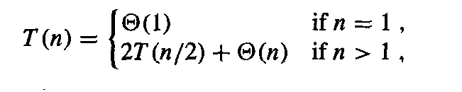
Recurrence Relations
Divide and conquer is a very common problem solving strategy in computer science
Recursion, where you solve a simpler version of the same problem, is a common application of divide and conquer
the recursion “bottoms out” in a base case
Merge sort divides a problem in “half” and solves each half separately
The recurrence relation is
Binary search divides a problem in half but solves for one of the two halves

Slide 3
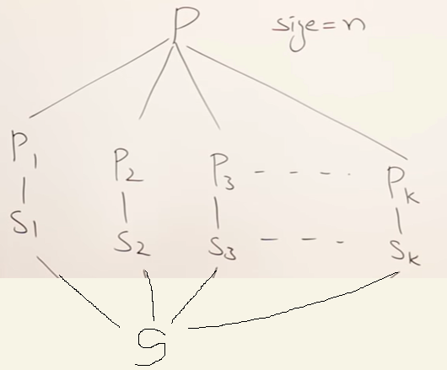
Divide and Conquer Strategy
Subproblem should be same as original problem
DAC is recursive.
There should be some method to combine solutions to subproblems.
You can use DAC strategy if you can divide the problem into subproblems of same type.

Slide 4
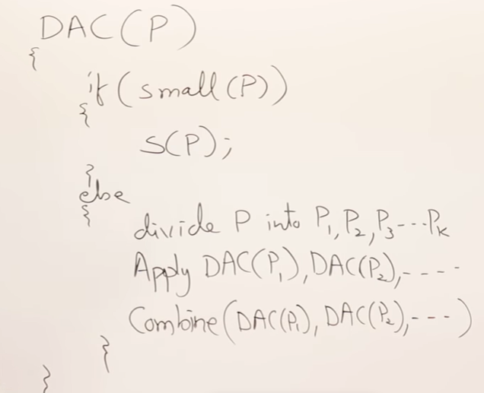
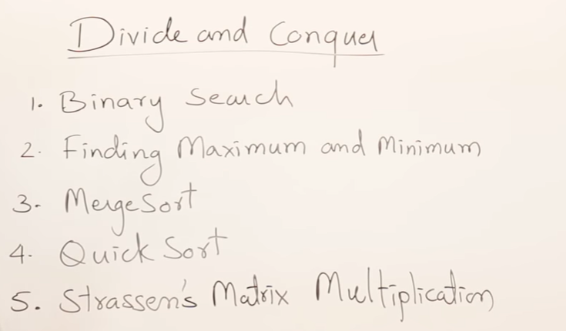
General method for DAC strategy
Problems for DAC strategy

Slide 5
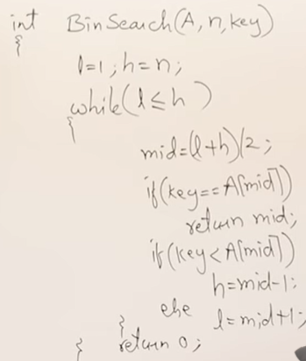
Binary search (Iterative method)
Time complexity?
Bet case:
Worst case:

Slide 6

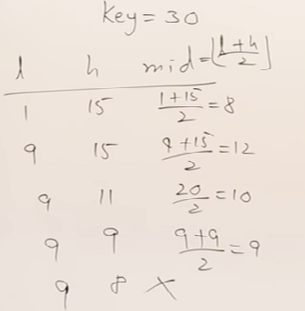
Binary search (Iterative method)
Time complexity?
Bet case:
Worst case:

Slide 7
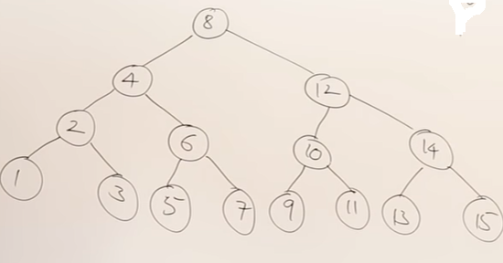
Max no. of comparisons for searching an element depends on height of a tree = log n =log 15 log 16=4
Min no. of comparisons for searching an element =1
WC: Max time to search an element= log n . Hence TC=O(log n)
BC: Min time to search an element= 1 . Hence TC=O(1)
AC: Average of time to search each element in the tree = ?

Slide 8
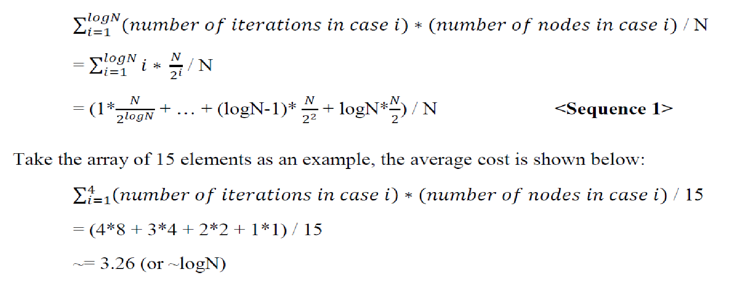
Average case analysis of Binary search

Slide 9
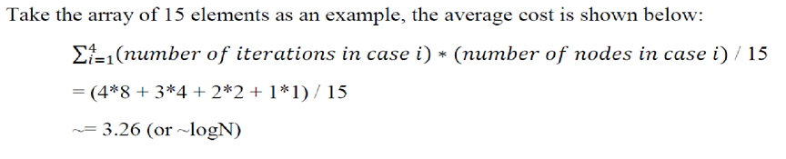
Average case analysis of Binary search

Slide 10
Binary search (Recursive method/DAC Algo)

Slide 11
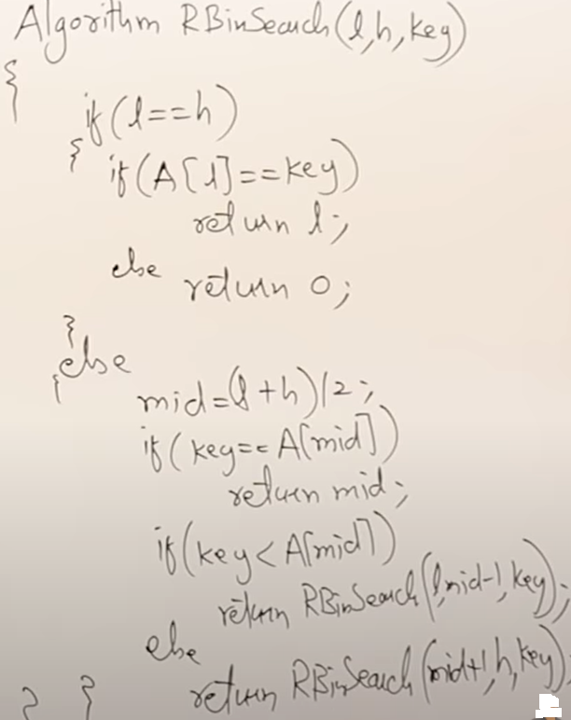
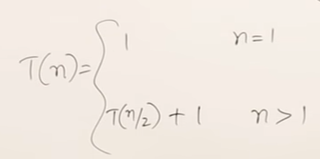

Binary search (Recursive method/DAC Algo)
Solving using Master’s Theorem TC= θ (log n)
a=1,b=2, = 0, k=0, p=0 > -1 . Hence using Case 2.1
,
TC= θ (log n)

Slide 12
Bubble Sort
Bubble sort is a very simple method that sorts the array elements by repeatedly moving the largest element to the highest index position of the array (in case of arranging elements in ascending order).
Method:
In bubble sorting, consecutive adjacent pairs of elements in the array are compared with each other.
If the element at lower index is greater than the element at the higher index, the two elements are interchanged so that the smaller element is placed before the bigger one.
This process is continued till the list of unsorted elements exhaust.

Slide 13
Bubble Sort Example
A[] = {30, 52, 29, 87, 63, 27, 18, 54}
Pass 1:
a)Compare 30 and 52. Since30<52, then no swapping is done
b)Compare 52 and 29. Since 52>29, swapping is done
30, 29, 52, 87, 63, 27, 19, 54
c) Compare 52 and 87. Since 52<87, no swapping is done
d) Compare, 87 and 63. Since, 87>83, swapping is done
30, 29, 52, 63, 87, 27, 19, 54
e) Compare87 and 27. Since 87>27, swapping is done
30, 29, 52, 63, 27, 87, 19, 54
f) Compare 87 and 19. Since 87>19, swapping is done
30, 29, 52, 63, 27, 19, 87, 54
g) Compare 87 and 54. Since 87>54, swapping is done
30, 29, 52, 63, 27, 19, 54, 87
Observe that after the end of the first pass, the largest element is placed at the highest index of the array. All the other elements are still unsorted.

Slide 14
Bubble Sort Example
Pass 2:
After Pass1 : 30, 29, 52, 63, 27, 19, 54, 87
a)Compare 30 and 29. Since 30>29, swapping is done
29, 30, 52, 63, 27, 19, 54, 87
b) Compare 30 and 52. Since 30<52, no swapping is done
c) Compare 52 and 63. Since 52<63, no swapping is done
d) Compare 63 and 27. Since 63>27, swapping is done
29, 30, 52, 27, 63, 19, 54, 87
e) Compare 63 and 19. Since 63>19, swapping is done
29, 30, 52, 27, 19, 63, 54, 87
f) Compare 63 and 54. Since 63>54, swapping is done
29, 30, 52, 27, 19, 54, 63, 87
Observe that after the end of the second pass, the second largest element is placed at the second highest index of the array. All the other elements are still unsorted.

Slide 15
Bubble Sort Example
Pass 3:
After pass 2: 29, 30, 52, 27, 19, 54, 63, 87
a)Compare 29 and 30. Since 29<30, no swapping is done
b)Compare 30 and 52. Since 30<52, no swapping is done
c)Compare 52 and 27. Since 52>27, swapping is done
29, 30, 27, 52, 19, 54, 63, 87
d) Compare 52 and 19. Since 52>19, swapping is done
29, 30, 27, 19, 52, 54, 63, 87
e) Compare 52 and 54. Since 52<54, no swapping is done
Observe that after the end of the third pass, the third largest element is placed at the third highest index of the array. All the other elements are still unsorted.

Slide 16
Bubble Sort Example
Pass 4:
After Pass 3 : 29, 30, 27, 19, 52, 54, 63, 87
a)Compare 29 and 30. Since 29<30, no swapping is done
b)Compare 30 and 27. Since 30>27, swapping is done
29, 27, 30, 19, 52, 54, 63, 87
c) Compare 30 and 19. Since 30>19, swapping is done
29, 27, 19, 30, 52, 54, 63, 87
d) Compare 30 and 52. Since 30<52, no swapping is done
Observe that after the end of the fourth pass, the fourth largest element is placed at the fourth highest index of the array. All the other elements are still unsorted.

Slide 17
Bubble Sort Example
Pass 5:
After Pass 4 : 29, 27, 19, 30, 52, 54, 63, 87
a)Compare 29 and 27. Since 29>27, swapping is done
27,29, 19, 30, 52, 54, 63, 87
b)Compare 29 and 19. Since 29>19, swapping is done
27,19,29, 30, 52, 54, 63, 87
c) Compare 29 and 30. Since 29<30, swapping is not done
27,19,29, 30, 52, 54, 63, 87
Observe that after the end of the fifth pass, the fifth largest element is placed at the fifth highest index of the array. All the other elements are still unsorted.

Slide 18
Bubble Sort Example
Pass 6:
After Pass 5: 27,19,29, 30, 52, 54, 63, 87
a)Compare 27 and 19. Since swapping is done
19,27 ,29, 30, 52, 54, 63, 87
b)Compare 27 and 29. No swapping is done
19,27 ,29, 30, 52, 54, 63, 87
Observe that after the end of the sixth pass, the sixth largest element is placed at the sixth highest index of the array. All the other elements are still unsorted.
Pass 7:
a) Compare 19 and 27 , No swapping is done.

Slide 19
Bubble Sort Example
BUBBLE_SORT(A, N)
Step 1: Repeat steps 2 For I = 0 to N-1 // Loop for Total No. of passes
Step 2: Repeat For J = 0 to N – I
Step 3: If A[J] > A[J + 1], then
SWAP A[J] and A[J+1]
[End of Inner Loop]
[End of Outer Loop]
Step 4: EXIT
// After every pass, one element will be in its correct position. So frequency of the inner loop will decrease with each pass.
Hence for every pass, the inner loop will be executed N-I times where N is the no. of elements in the array and I is the count of the pass.

Slide 20
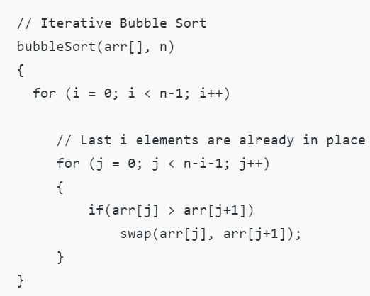

Find worst case and Best Case complexity of Bubble sort
//Recursive bubble sort
void bubbleSort(int arr[], int n)
{
if (n > 1)
{
for (i=0; i<n-1; i++)
{if (arr[i] > arr[i+1])
swap(arr[i], arr[i+1]);
}
// Largest element is fixed,
// recur for remaining array
bubbleSort(arr, n-1);
}
}
RR =?
WC TC= O(n²)
TC= O(n²)
BC TC=O(n)

Slide 21
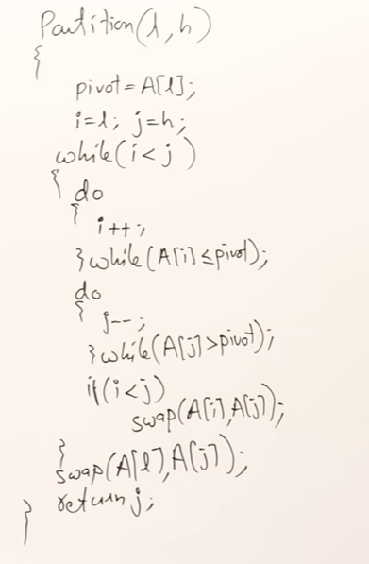
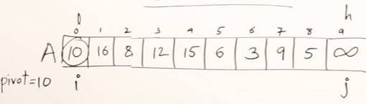
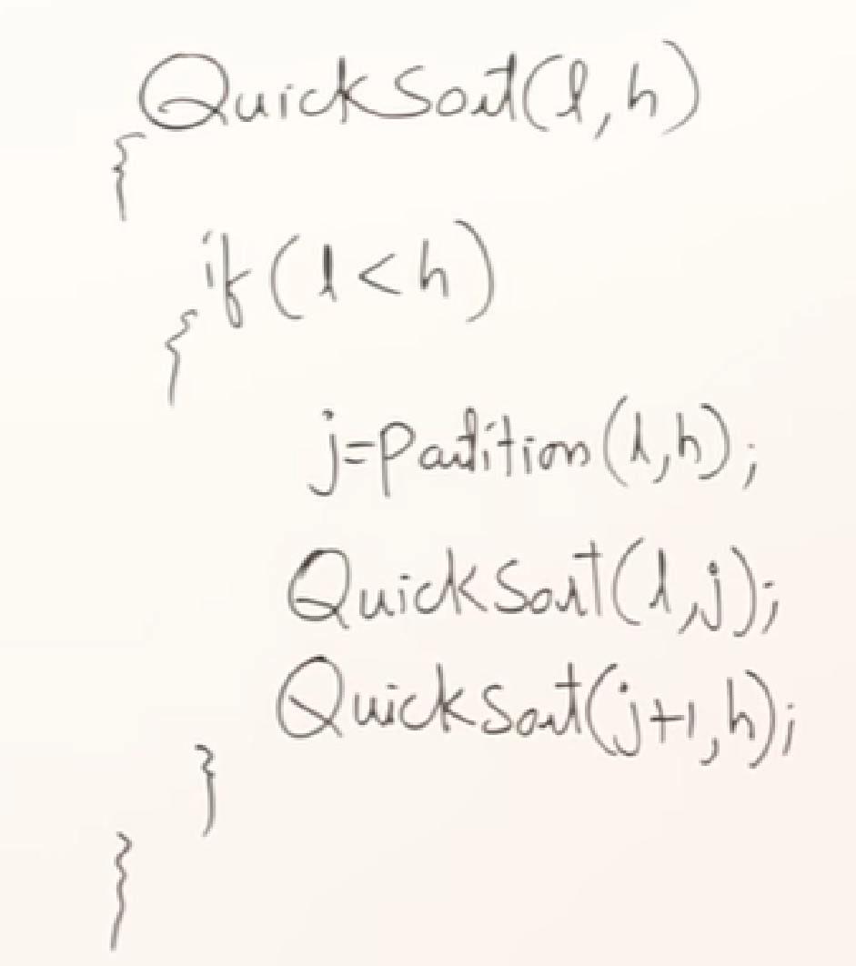
Quick Sort(DAC/Recursive algorithm): Partitioning Algo
Find sorted position of pivot. It gives the position at which list will be partitioned.
TC=O(n)
TC=?

Slide 22
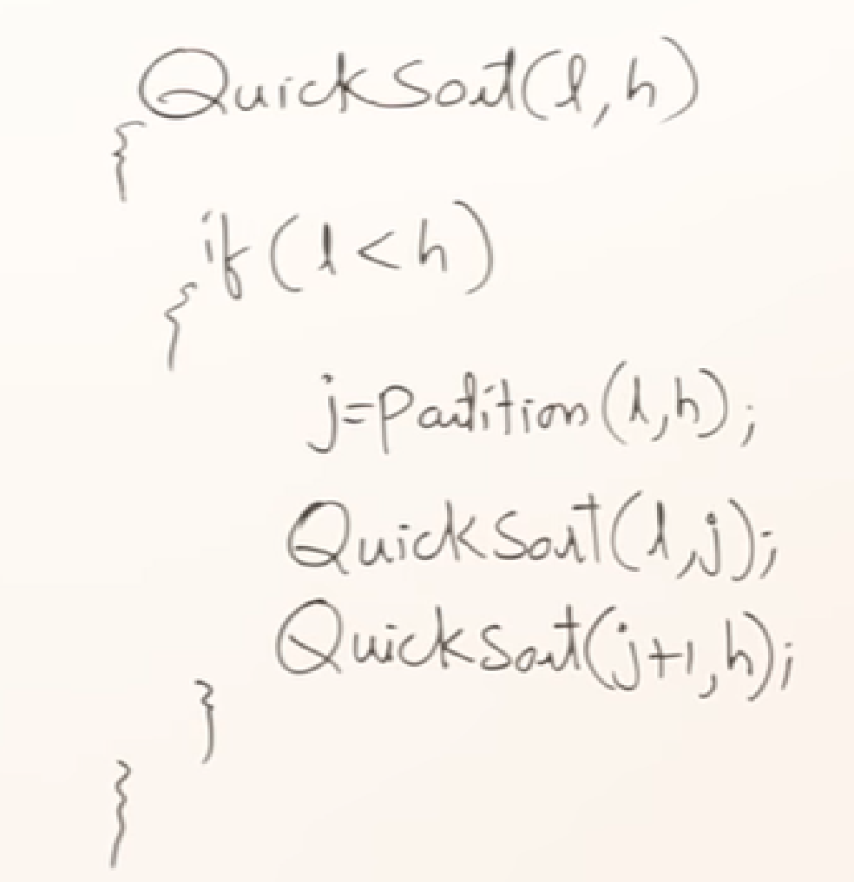
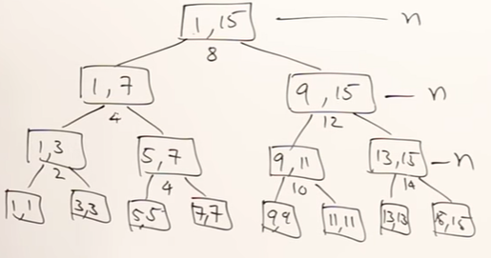
Quick Sort Analysis
Best Case: ??
Partitioning is always done at the middle.(i.e median element always selected as pivot)
Achieving best case is not possible with Quicksort.
RR=?
RR for BC is :
T(n) = 2T(n/2) + n , n>1
= 1 , n=1
Solving using Master’s Theorem,
TC= O(n log n)
T(n)= n + n + n……..log n times = n log n
BC TC = O(nlog n)

Slide 23
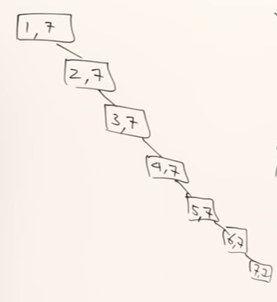
Quick Sort Analysis
Worst Case: ??
Worst Case: Partitioning is always done at beginning or at the end.
i.e list is already sorted(ASC/DESC order.) RR=?
RR: T(n) = T(n-1) + T(1) + n = T(n-1)+1+n = T(n-1) + n
T(n) = T(n-1) + n , n>1
= 1 , n=1
Solving using substitution method, TC= O(n²)
n comparisisons
n-1 comparisisons
n-2 comparisisons
n-3 comparisisons
2 comparisison
1 comparisison
T(n)= 1+2+3+…..+(n-1)+n = n(n+1)/2 = O(n²)

Slide 24
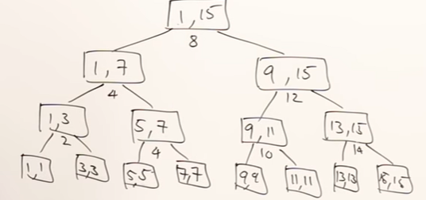
Best Case: Partitioning is always done at the middle.
T(n)= n + n + n……..log n times = n log n
BC TC = O(nlog n)
Worst Case: Partitioning is always done at beginning or at the end. i.e list is already sorted.
T(n)= 1+2+3+…..+(n-1)+n = n(n+1)/2 = O(n²)

Slide 25
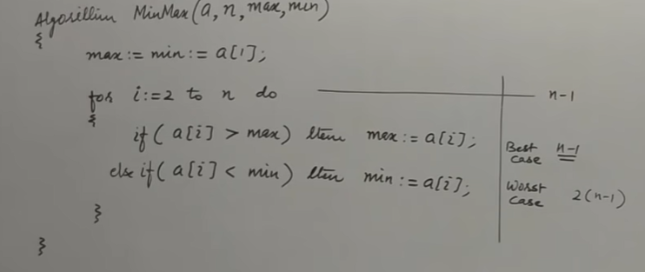
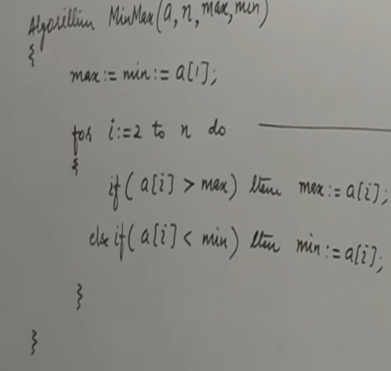
Finding minimum and maximum(Non-recursive method)
Best Case and Worst case???
Best Case: Array sorted in ASC order
Worst case: Array sorted in DESC order
Best Case: n-1 comparisions TC =O(n)
Worst case: Both if statements will be executed.
No of comparisions= 2(n-1) TC=O(n)
Average Case: TC=O(n)

Slide 26
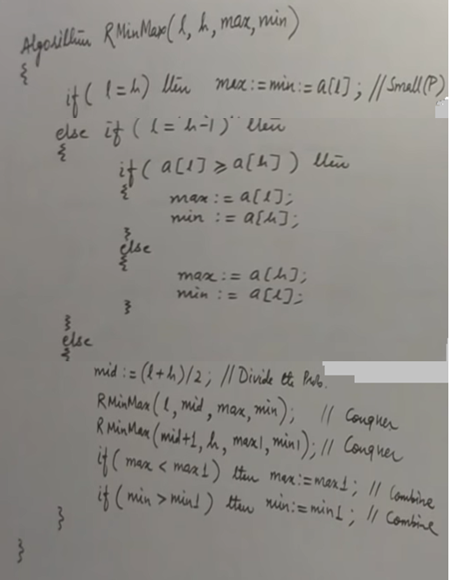
Finding minimum and maximum(DAC/recursive method)

Slide 27
Finding minimum and maximum(DAC/recursive method)

Slide 28

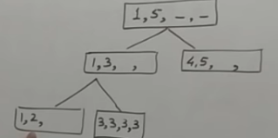
Finding minimum and maximum(DAC/recursive method)
Mid=(1+5)/2=3
Mid=(1+3)/2=2
L = h-1 case
l = h-1 case
L = h case
max=20, min=3

Slide 29

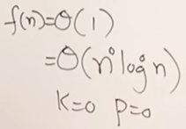


TC: Finding minimum and maximum(DAC/recursive method)
1 -----
1 -----
T(n) = 2T(n/2) + 1
Using Master method, a=2, b=2
=
1 -----
T(n/2) -----
T(n/2) -----
1 ----
1 -----

Slide 30
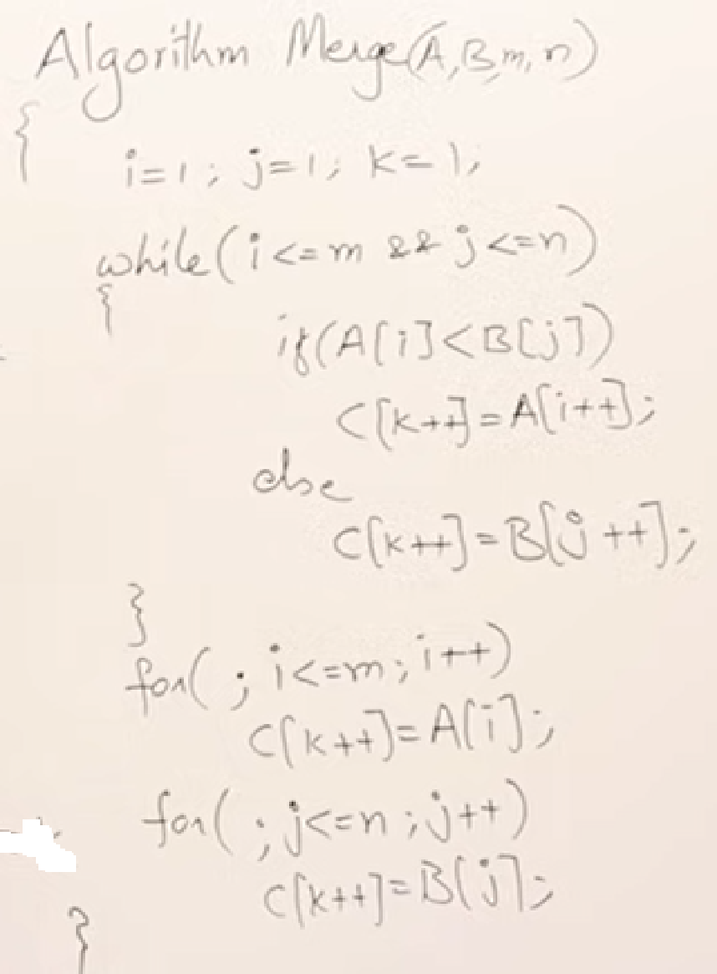
Merge Sort
Write an algorithm to merge two sorted lists A and B of size m and n respectively and find its TC

Slide 31
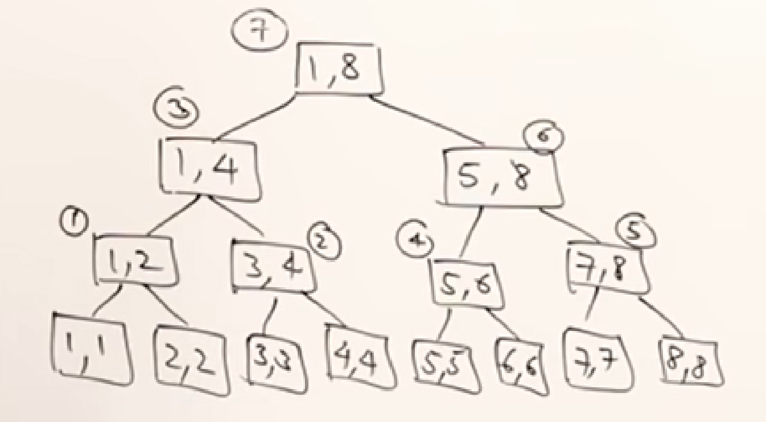
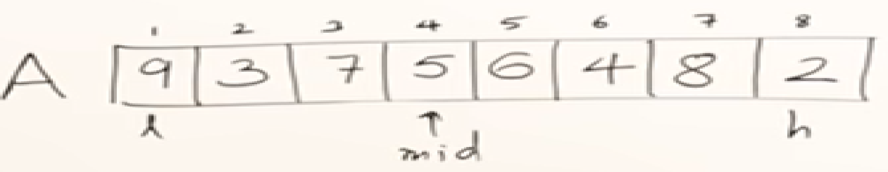
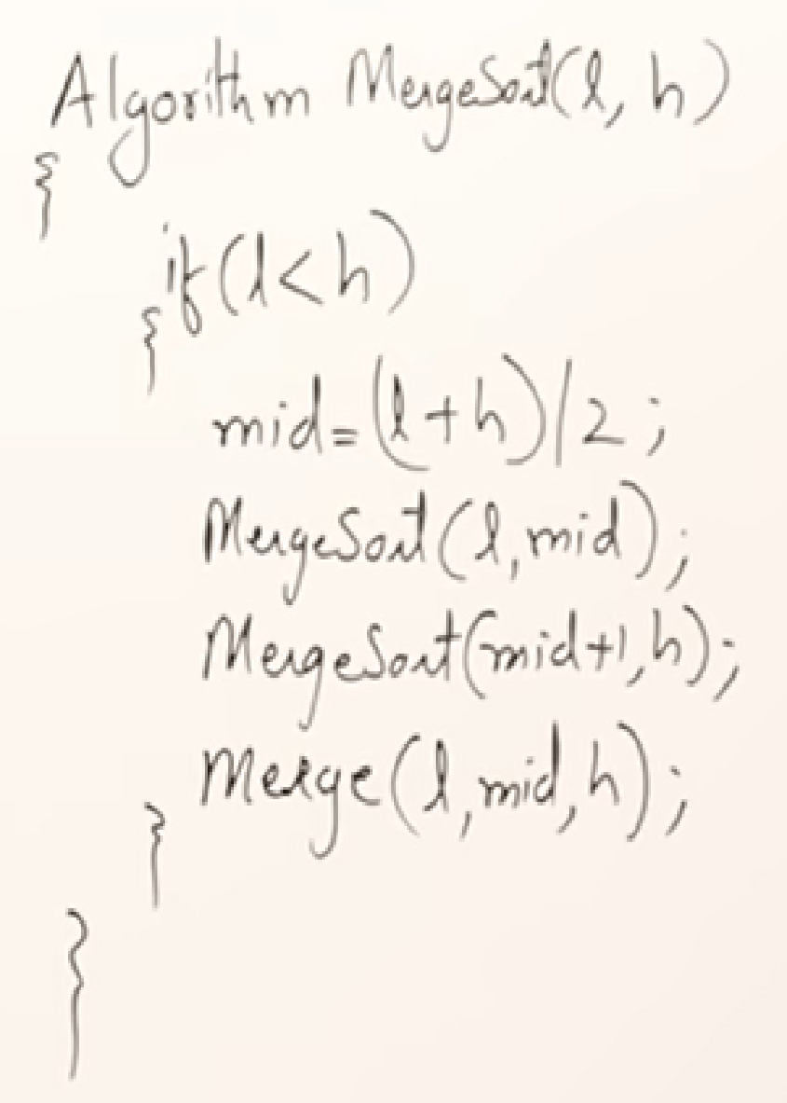
Merge Sort Algorithm

Slide 32
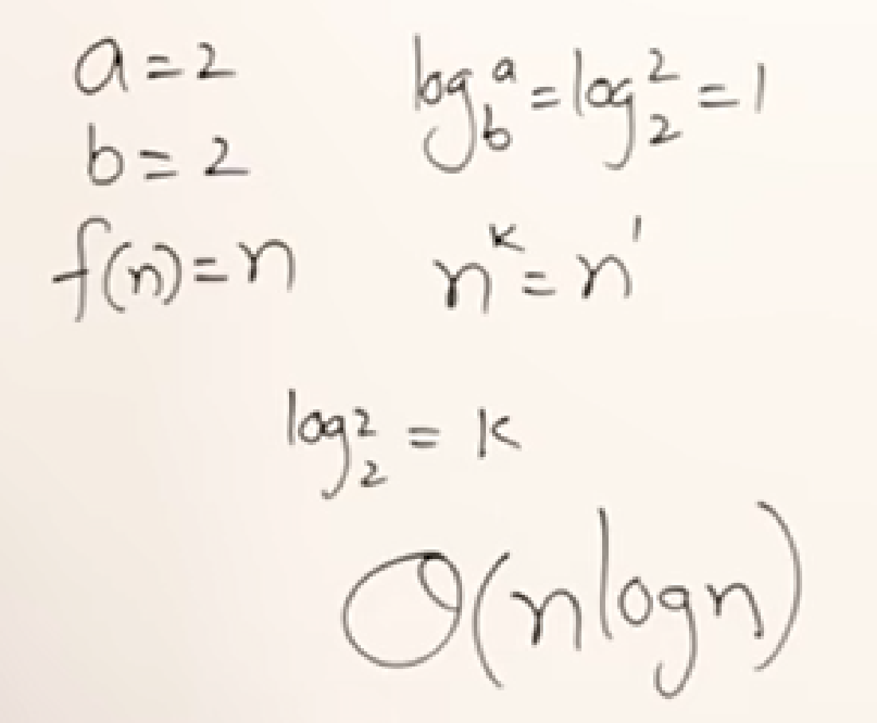
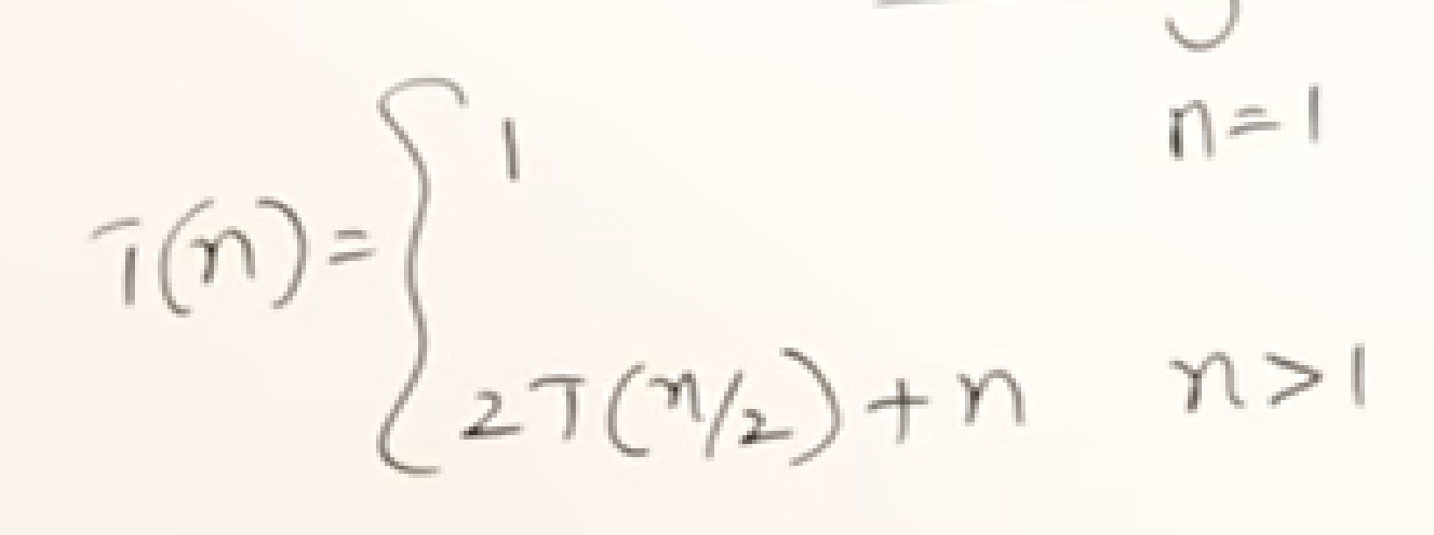
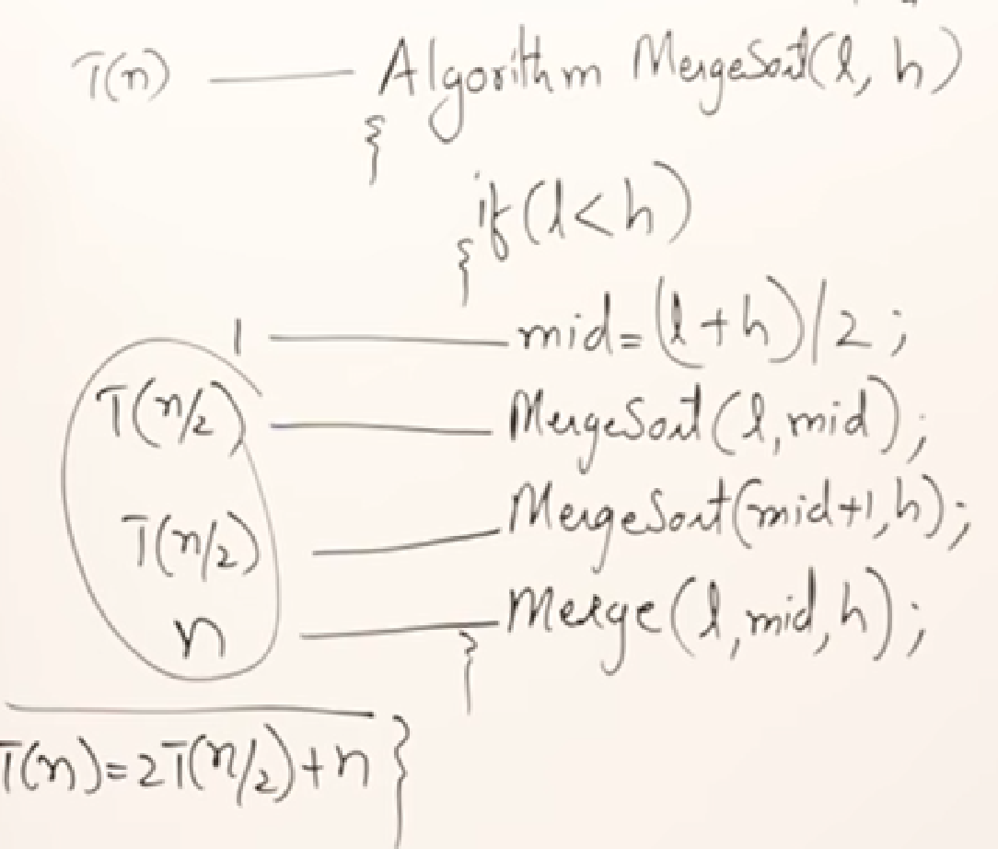
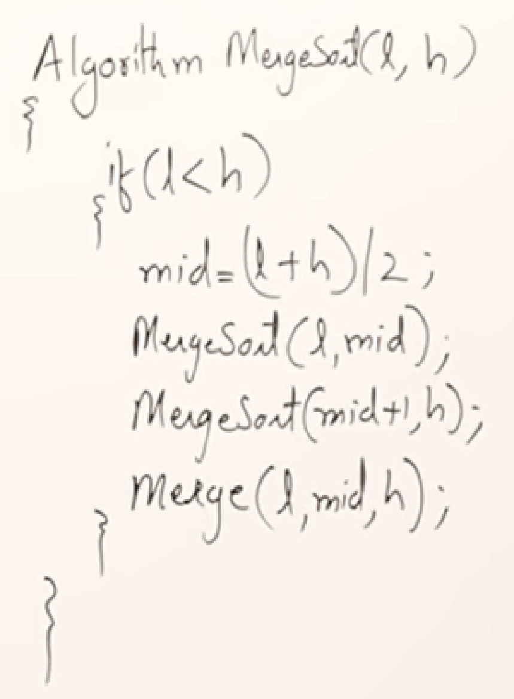
Merge Sort Algorithm Time Complexity

Slide 33
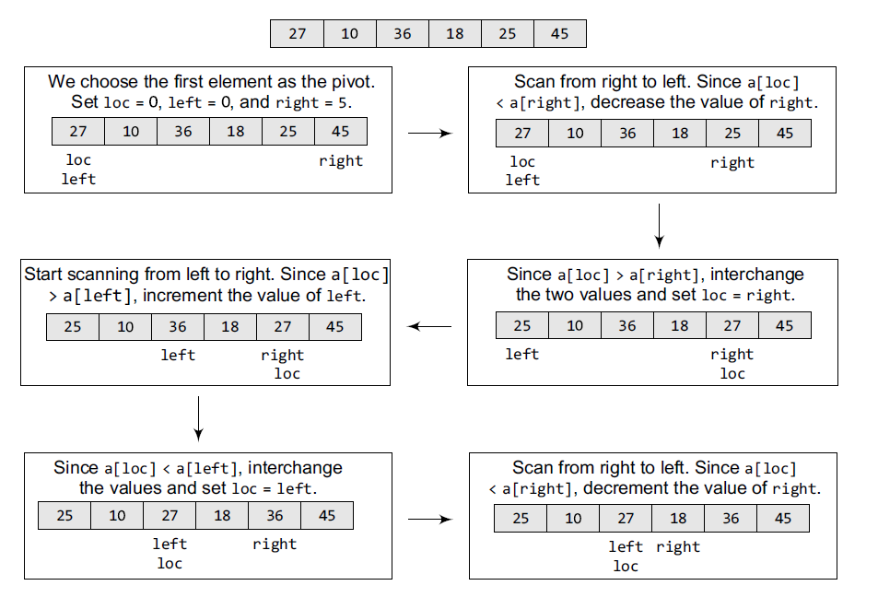

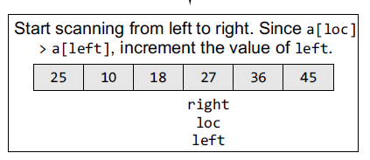
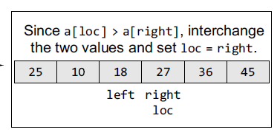


Slide 34
END

